Slide 1

DATA SCIENCE BOOTCAMP Module 2
Rare Event Modeling
Anindya Moitra

Slide 2
Confusion Matrix:
Predicted class | Actual Class |  | Marginal
 | Yes | No
Yes | True Positives (TP) | False Positive (FP) | P
No | False Negative (FN) | True Negatives (TN) | N
Marginal | P’ | N’ | Total
If these results are from a population-based study, prevalence can be calculated as follows:
Prevalence of Disease= P’/ Total
Sensitivity is the probability that a test will indicate ‘Y=1' among those with the Y=1:
Sensitivity/ Recall: TP / P’
Specificity is the fraction of those “Y=0” who will have a negative test result:
Specificity: TN / N’
Sensitivity and specificity are characteristics of the test. The population does not affect the results.
Accuracy = (TP + TN) / Total; Error rate: 1 – Accuracy
Notes:
Precision and recall are both similar to accuracy, but both are very difficult to understand conceptually. Precision is sort of like accuracy but it looks only at the data you predicted positive. Recall is also sort of like accuracy but it looks only at the data that is “relevant” in some way.
Refer: https://select-statistics.co.uk/blog/sensitivity-specificity-and-predictive-values-what-is-the-best-way-to-measure-the-performance-of-binary-classification-models/

Slide 3
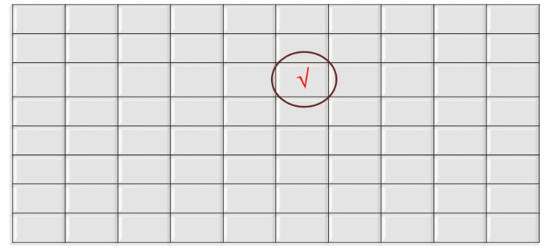
What is Rare Event Modeling?
Only 531 out of a population of 50,431 customer closed their saving account in a year, but the dollar value lost because of such closures was more than $ 5 Million
The best way to arrest these attrition was by predicting the propensity of attrition for individual customer and then pitch retention offers to these identified customers. This was a typical case of modeling in a rare event population. This kind of problems are also very common in Health care analytics. –
In such analysis, there are two challenges : (1) Accurate prediction is difficult because of small sample bias (2) The accuracy of prediction need to be extremely high to make an implementable strategy. This is because high number of false positive, unnecessarily burdens the retention budgets

Slide 4
Example
Total Observations = 1000
Fraudulent Observations =20
Non-Fraudulent Observations = 980
Event Rate= 2 %
Fraud Indicator = 0 for Non-Fraud Instances
Fraud Indicator = 1 for Fraud

Slide 5
Handling Imbalanced Datasets: Random Under-Sampling
Random Under sampling aims to balance class distribution by randomly eliminating majority class examples. This is done until the majority and minority class instances are balanced out.
Total Observations = 1000
Fraudulent Observations =20
Non Fraudulent Observations = 980
Event Rate= 2 %
In this case we are taking 10 % samples without replacement from Non Fraud instances. And combining them with Fraud instances.
Non Fraudulent Observations after random under sampling = 10 % of 980 =98
Total Observations after combining them with Fraudulent observations = 20+98=118
Event Rate for the new dataset after under sampling = 20/118 = 17%
Advantages
It can help improve run time and storage problems by reducing the number of training data samples when the training data set is huge.
Disadvantages
It can discard potentially useful information which could be important for building rule classifiers.
The sample chosen by random under sampling may be a biased sample. And it will not be an accurate representative of the population. Thereby, resulting in inaccurate results with the actual test data set.

Slide 6
Handling Imbalanced Datasets: Random Over-Sampling
Over-Sampling increases the number of instances in the minority class by randomly replicating them in order to present a higher representation of the minority class in the sample.
Total Observations = 1000
Fraudulent Observations =20
Non Fraudulent Observations = 980
Event Rate= 2 %
In this case we are replicating 20 fraud observations 20 times.
Non Fraudulent Observations =980
Fraudulent Observations after replicating the minority class observations= 400
Total Observations in the new data set after oversampling=1380
Event Rate for the new data set after under sampling= 400/1380 = 29 %
Advantages
Unlike under sampling this method leads to no information loss.
Outperforms under sampling
Disadvantages
It increases the likelihood of overfitting since it replicates the minority class events.

Slide 7
Handling Imbalanced Datasets: Cluster-Based Over Sampling
In this case, the K-means clustering algorithm is independently applied to minority and majority class instances. This is to identify clusters in the dataset. Subsequently, each cluster is oversampled such that all clusters of the same class have an equal number of instances and all classes have the same size.
Total Observations = 1000 / Fraudulent Observations =20 / Non Fraudulent Observations = 980 / Event Rate= 2 %
Majority Class Clusters
Cluster 1: 150 Observations / Cluster 2: 120 Observations / Cluster 3: 230 observations / Cluster 4: 200 observations / Cluster 5: 150 observations / Cluster 6: 130 observations /
Minority Class Clusters
Cluster 1: 8 Observations / Cluster 2: 12 Observations
After oversampling of each cluster, all clusters of the same class contain the same number of observations.
Majority Class Clusters
Cluster 1: 170 Observations / Cluster 2: 170 Observations / Cluster 3: 170 observations/ Cluster 4: 170 observations / Cluster 5: 170 observations / Cluster 6: 170 observations /
Minority Class Clusters
Cluster 1: 250 Observations / Cluster 2: 250 Observations
Event Rate post cluster based oversampling sampling = 500/ (1020+500) = 33 %.
Advantages
This clustering technique helps overcome the challenge between class imbalance. Where the number of examples representing positive class differs from the number of examples representing a negative class.
Also, overcome challenges within class imbalance, where a class is composed of different sub clusters. And each sub cluster does not contain the same number of examples.
Disadvantages
The main drawback of this algorithm, like most oversampling techniques is the possibility of over-fitting the training data.

Slide 8
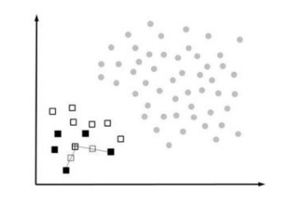
Informed Over Sampling: Synthetic Minority Over-sampling Technique (1/4)
Synthetic Minority Oversampling (SMOTE) works by creating synthetic observations based upon the existing minority observations . This is illustrated in the below figure where the circles represent the majority class (e.g. non-fraud) and the squares the minority class (e.g. fraud). For each minority class observation, SMOTE calculates the k nearest neighbors. Let’s assume we consider the crossed square and pick the 5 nearest neighbors represented by the black squares. Depending upon the amount of oversampling needed, one or more of the k-nearest neighbors are selected to create the synthetic examples. Let’s say our oversampling percentage is set at 200%. In this case, 2 of the 5 nearest neighbors are selected at random. The next step is then to randomly create two synthetic examples along the line connecting the observation under investigation (crossed square) with the two random nearest neighbors. These 2 synthetic examples are represented by dashed squares in the figure.
As an example, consider an observation with characteristics (e.g. age and income) of 30 and 1000, and its nearest neighbor with corresponding characteristics 62 and 3200. We generate a random number between 0 and 1, let’s say 0.75. The synthetic example then has age 30+0.75*(62-30) or 54, and income 1000+0,75*(3200-1000)=2650. SMOTE then combines the synthetic oversampling of the minority class with undersampling the majority class. Note that in their original paper, Chawla et al (2001) also developed an extension of SMOTE to work with categorical variables. Empirical evidence has shown that SMOTE usually works better than either under- or oversampling. Also for fraud detection it has proven to be very valuable.

Slide 9
Informed Over Sampling: Synthetic Minority Over-sampling Technique (2/4)
This technique is followed to avoid overfitting which occurs when exact replicas of minority instances are added to the main dataset. A subset of data is taken from the minority class as an example and then new synthetic similar instances are created. These synthetic instances are then added to the original dataset. The new dataset is used as a sample to train the classification models.
Total Observations = 1000 / Fraudulent Observations = 20 / Non Fraudulent Observations = 980 / Event Rate = 2 %
A sample of 15 instances is taken from the minority class and similar synthetic instances are generated 20 times
Post generation of synthetic instances, the following data set is created
Minority Class (Fraudulent Observations) = 300
Majority Class (Non-Fraudulent Observations) = 980
Event rate= 300/1280 = 23.4 %.
Advantages
Mitigates the problem of overfitting caused by random oversampling as synthetic examples are generated rather than replication of instances
No loss of useful information
Disadvantages
While generating synthetic examples SMOTE does not take into consideration neighboring examples from other classes. This can result in increase in overlapping of classes and can introduce additional noise
SMOTE is not very effective for high dimensional data

Slide 10
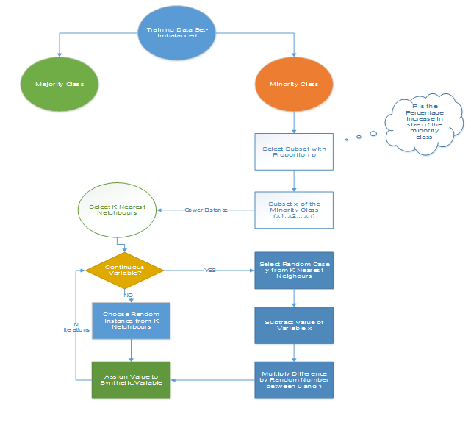
Informed Over Sampling: Synthetic Minority Over-sampling Technique (3/4)

Slide 11
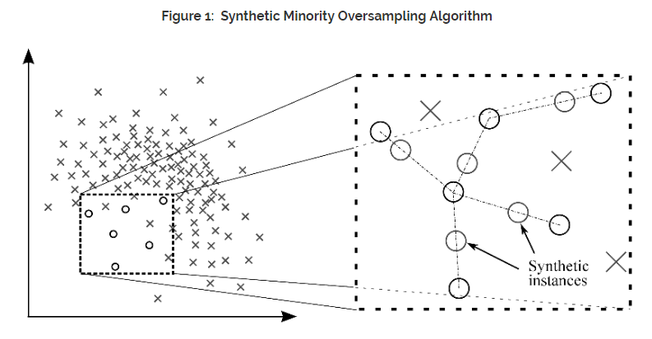
Informed Over Sampling: Synthetic Minority Over-sampling Technique (4/4)

Slide 12
Modified synthetic minority oversampling technique (MSMOTE)
It is a modified version of SMOTE. SMOTE does not consider the underlying distribution of the minority class and latent noises in the dataset. To improve the performance of SMOTE a modified method MSMOTE is used.
This algorithm classifies the samples of minority classes into 3 distinct groups – Security/Safe samples, Border samples, and latent nose samples. This is done by calculating the distances among samples of the minority class and samples of the training data.
Security samples are those data points which can improve the performance of a classifier. While on the other hand, noise are the data points which can reduce the performance of the classifier. The ones which are difficult to categorize into any of the two are classified as border samples.
While the basic flow of MSOMTE is the same as that of SMOTE (discussed in the previous section). In MSMOTE the strategy of selecting nearest neighbors is different from SMOTE. The algorithm randomly selects a data point from the k nearest neighbors for the security sample, selects the nearest neighbor from the border samples and does nothing for latent noise.

Slide 13
Effects of Oversampling
Oversampling does not affect the slopes (parameter estimates), but it effects the intercepts (make it too high). In other words, parameter estimates remain same after sampling but intercepts increases very much after sampling.
Predicted probabilities are affected as it is calculated taking both parameter estimates and intercept (incorrect intercept as stated above). It increases after sampling as intercept is overestimated.
Oversampling does not affect sensitivity or specificity measures but false positive and negative rates are affected.
ROC curve is not affected by oversampling.
Oversampling does not affect rank ordering (sorting based on predicted probability) because adjusting oversampling is just a linear transformation. Hence, it does not affect Gain and Lift charts if you score on out of time sample or unsampled validation dataset. However, if you compare lift of unsampled and sampled data of training dataset, gain charts and lift charts are affected as proportion of events got changed. For example, predicted probability score is 80% in one observation. After oversampling, ratio is 50:50. The lift on the sampled data is 80%/50% = 1.6. After adjusting probability, the adjusted probability score is 30.8%. The lift on the original data is 3.08 (30.8% / 10%).

Slide 14
Modeling process and Adjustment
Leave as it is and continue iterating
Intercept Adjustment & Correct probability
Class weight Adjustment
Ensemble techniques – Bagging & Boosting

Slide 15
Leave as it is and continue iterating
Total Observations = 1000 / Fraudulent Observations = 20 / Non Fraudulent Observations = 980 / Event Rate = 2 %
Post Adjustment:
Development Sample – Create multiple scenario: Event Rate – 10%, 15%, 20%, 25%, 30% etc.
Validation Sample: 2%
Build the model on Development sample and test it on validation sample
Cross validation framework can also be tried
Compare the standard checkpoints
See the trade-off b/w Accuracy, precision and Recall – Calculate F1 Score
Select the case where all the checkpoints are satisfied

Slide 16
Intercept Adjustment (1/3)
Correct Intercept: offset method (in SAS)
p1: the population rate (before oversampling) - Let's say 1%.
r1: the sample rate (post oversampling - 10%)
α1 is the intercept from oversampled data.
The intercept term for final model α when scoring non sampled population -
α= α1 + log ((p1(1-r1))/(1-p1) r1) where log represents the natural logarithm (loge)
Implementing Offset Method in SAS:
You can use the PRIOREVENT= option in the SCORE statement to specify the prior event probability.
proc logistic data=training; model attrition(event='1')= Fees Balance Withdrawal Interest; score data=valid out=scored priorevent=0.05; run;
Note : 0.05 means the 5% of the target event before sampling.

Slide 17
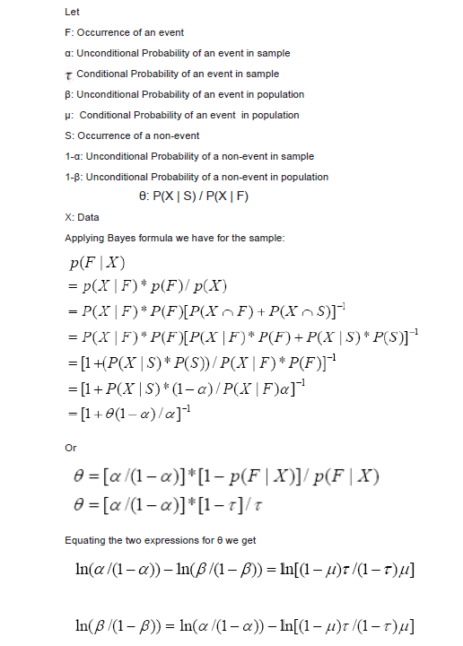
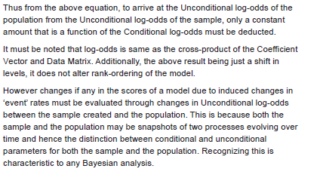
Intercept Adjustment – Proof (2/3)

Slide 18
Correct probability- Weight Method (3/3)
Correct probability- Weight Method
In the equation below, P_1 denotes predicted probability for an event, P_0 denotes predicted probability for non-event.
Step 1 : A = P_1 / (Oversampled % of events / Original % of events)
Step 2 : B = P_0 / (Oversampled % of non-events / Original % of non-events)
Step 3 : Adj_P_1 = A / (A+B)
Step 4 : Adj_P_0 = B / (A+B)
Solve the above equation :
Adj_P_1 = 1/(1+((1/original % of events)-1)/((1/oversampled % of events)-1)*[(1/P_1)-1])
Adj_P_0 = 1/(1+((1/original % of non-events)-1)/((1/oversampled % of non-events)-1)*[(1/P_0)-1])
Before Sampling - 1 - 5% and 0 -95%
Post Sampling - 1 - 50% and 0 -50%
Adj_P_1 = 1/(1+((1/0.05)-1)/((1/0.5)-1)*((1/p_1)-1))
Adj_P_0 = 1/(1+((1/0.95)-1)/((1/0.5)-1)*((1/p_0)-1))

Slide 19
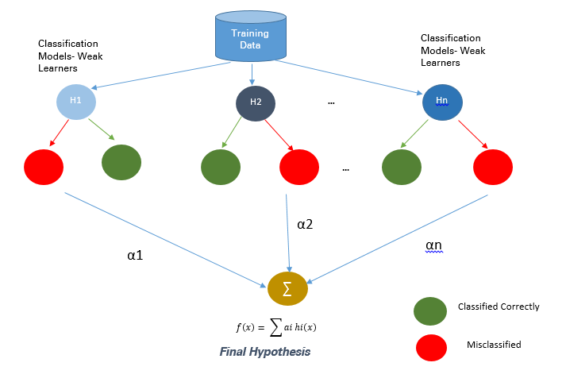
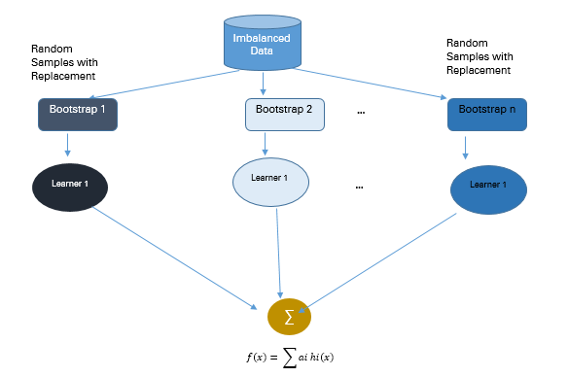
Bagging & Boosting
Bagging
Boosting

Slide 20
DATA SCIENCE BOOTCAMP Module 2
Uplift Modeling
Anindya Moitra

Slide 21
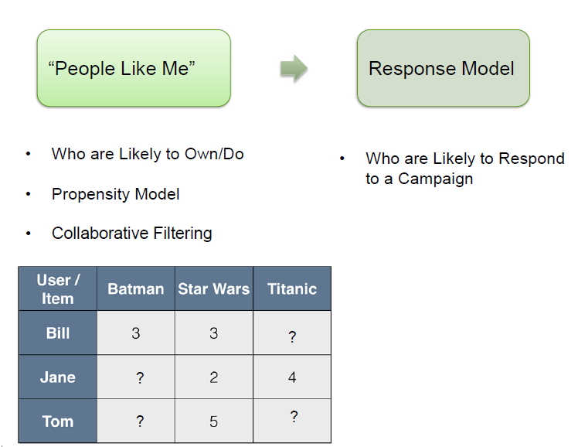
Models for Personalization

Slide 22
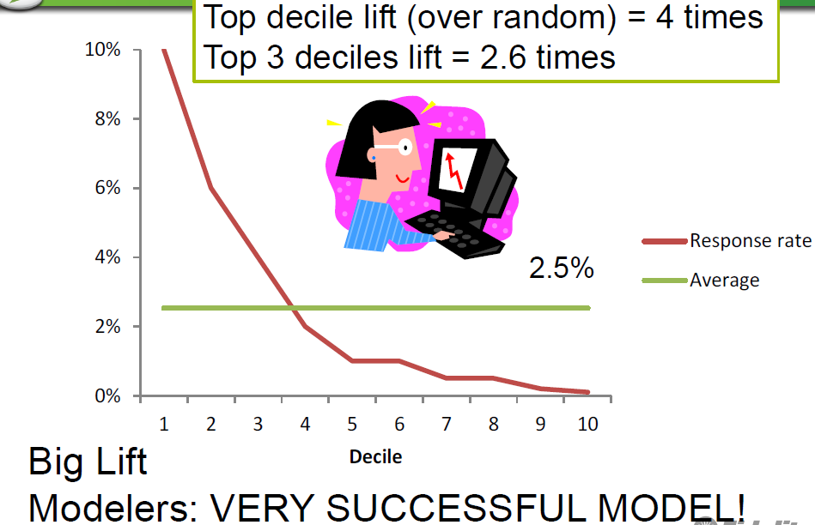
Response Modeling

Slide 23
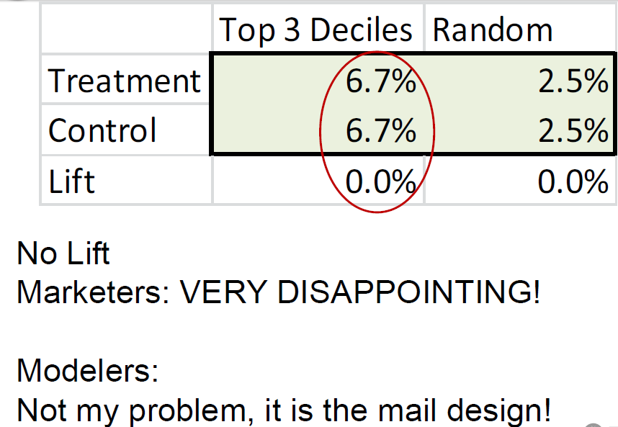
Campaign Results

Slide 24
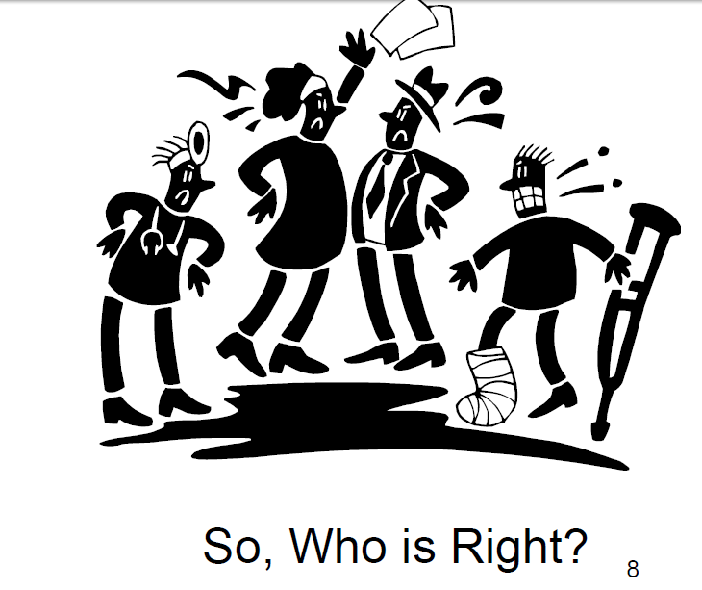
So Who is Right?

Slide 25
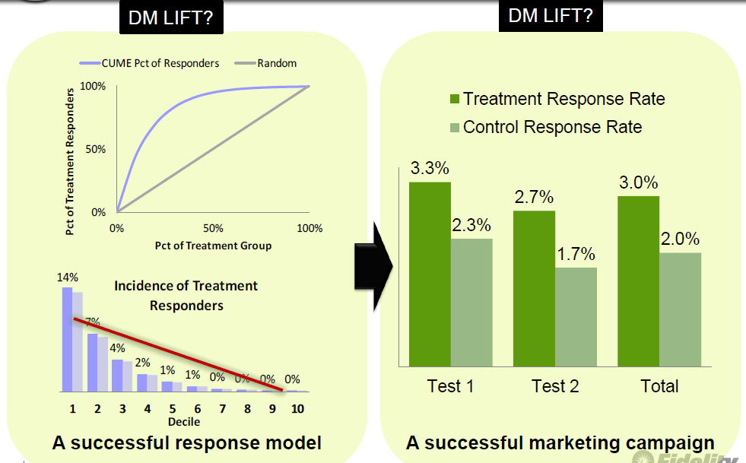
What's Wrong with this Picture..

Slide 26
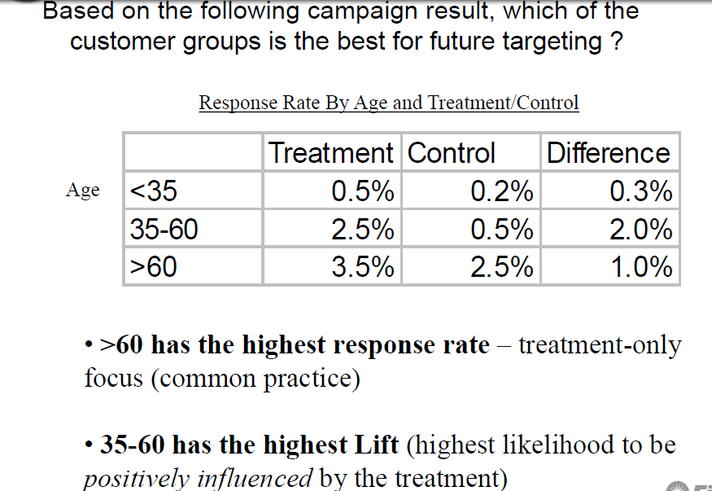
Motivation…

Slide 27
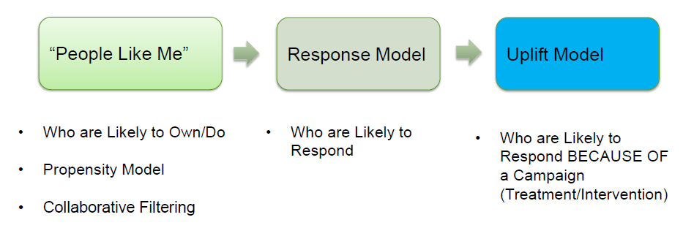
Models for Personalization…

Slide 28
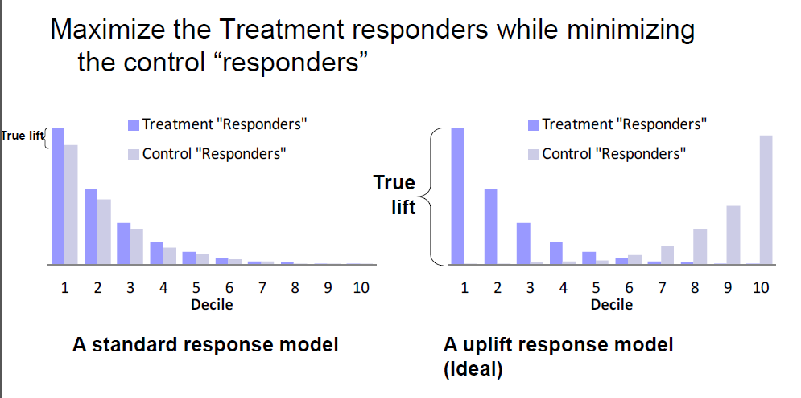
The Uplift Model Objective..

Slide 29
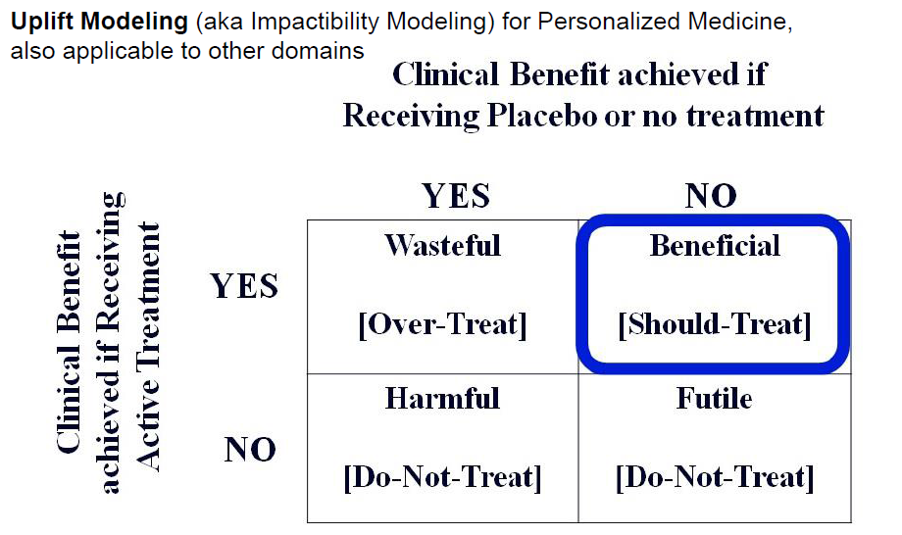
Healthcare Example

Slide 30
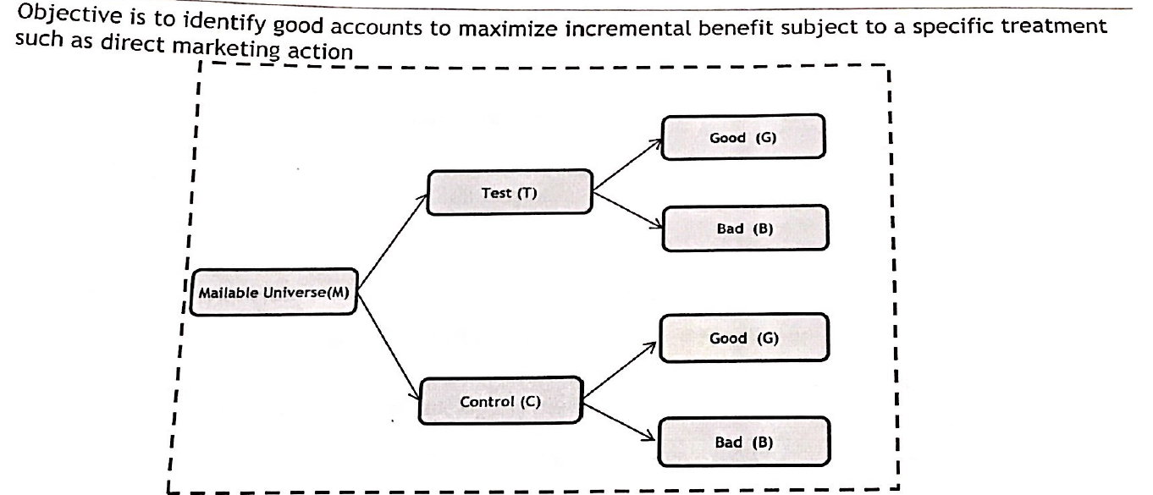
Modeling Steps

Slide 31
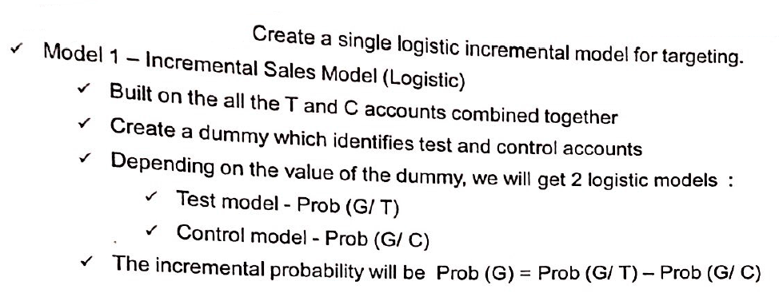
Approach-I

Slide 32
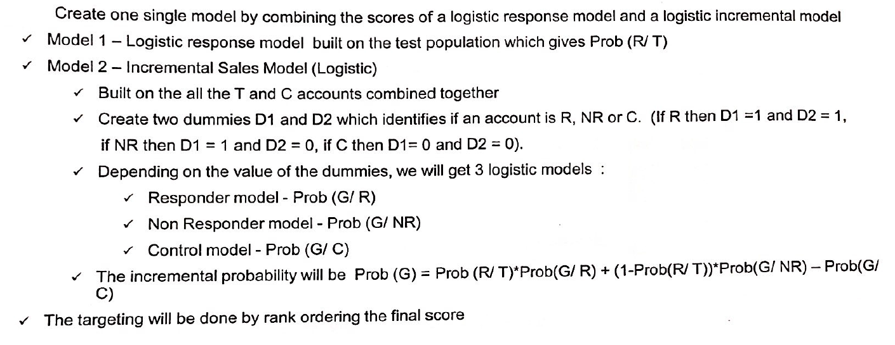
Approach-II

Slide 33
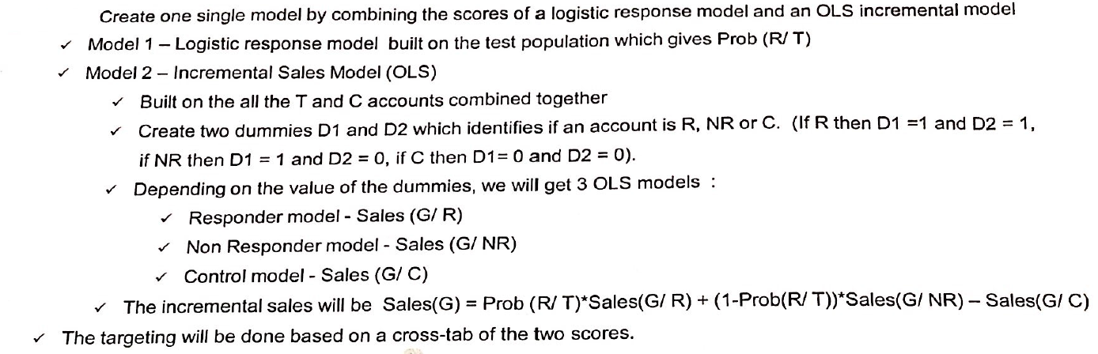
Approach-III

Slide 34
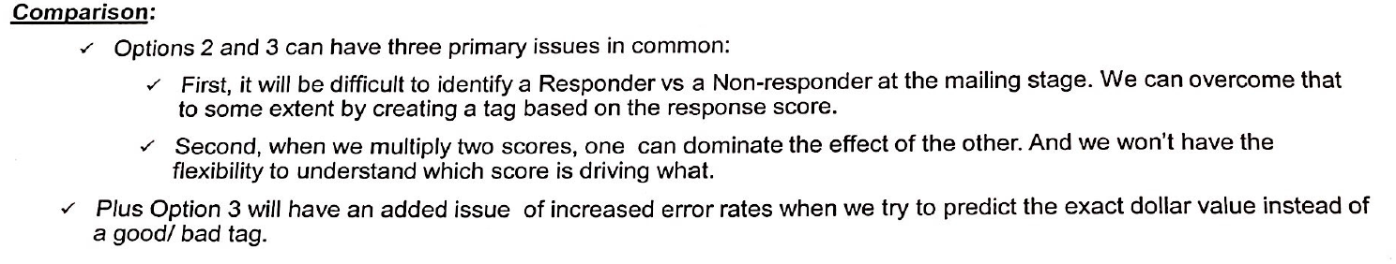
Comparison

